Slide 1
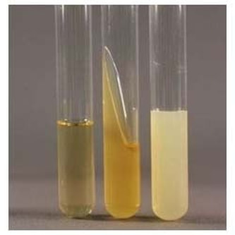
BT233 – General Microbiology Laboratory
Growth Morphology

Slide 2
Isolation of bacteria from the source (Soil)
(Non-contaminated culture)
Purification
(Pure culture)
Identification
Microscopic Morphology
Macroscopic Morphology
- Colony Morphology:
(Size, surface topography, pigmentation and form)
- Growth Morphology

Slide 3
Growth Morphology
The same type of bacteria can have different growth morphologies depending on the type of media it is grown on
The growth morphologies of the same type of bacteria can be determined by cultivate it on different types of media
The growth morphologies of different types of bacteria can be determined by cultivate them on the same type of media

Slide 4
In this experiment, We will study the growth morphology of the bacteria we purified in the previous lab using the following types of media:
1. Nutrient broth
2. Nutrient agar slant

Slide 5
Type of media | Status | % of the solidifying agent (Agar) | Example
Broth | Liquid | 0% | Nutrient broth
Agar | Solid | > 1% | Nutrient agar slant
Molten | Semisolid | < 1% | Brain heart infusion agar
The melting and solidifying points of agar:
- Melting point = solidifying point (42-43°C)
- Higher than 43°C = agar is liquid
- Lower than 42°C = agar is solid

Slide 6
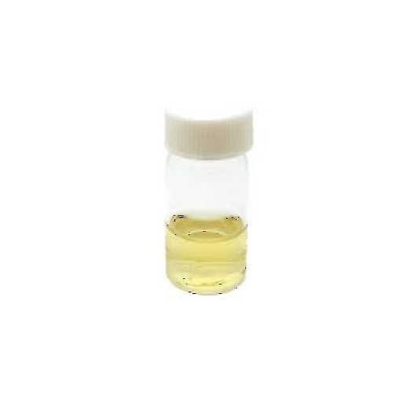
Nutrient Broth
(under aseptic conditions)
Flame the mouth of the nutrient broth vail
Take one loopful from your pure culture to the nutrient broth vail by using a sterile cooled inoculating loop
Gently shake the loop to disperse the bacteria
Reflame the mouth of the vail and close the lid
Shake it by vortex very well to get uniform distribution of bacteria
incubate it up right for 24 hours then take the results according where the bacteria grew

Slide 7
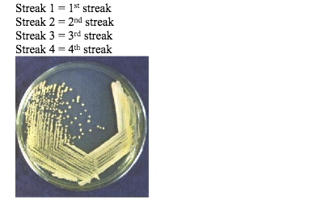
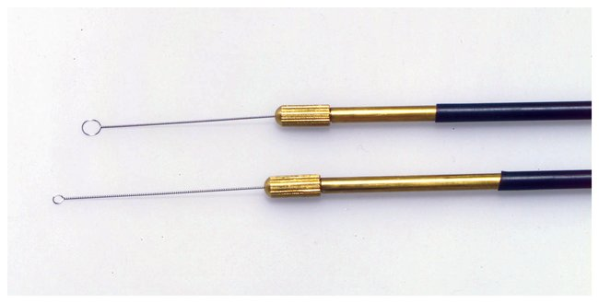
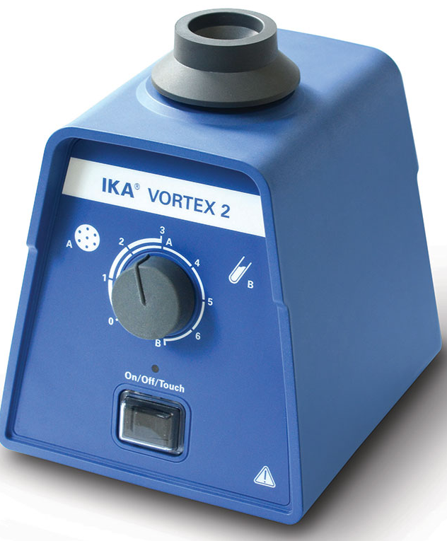
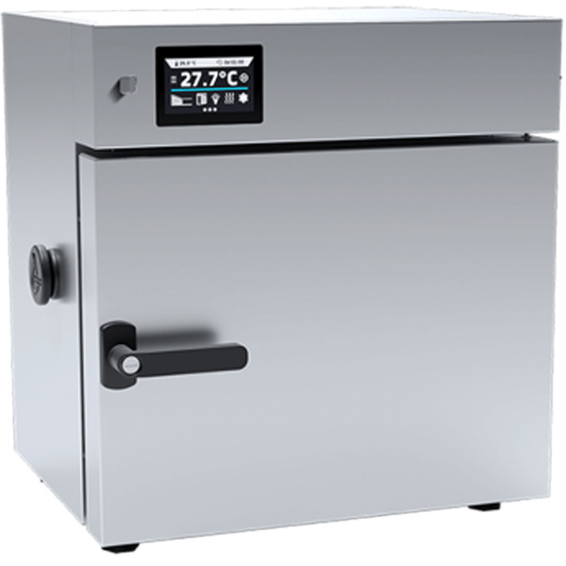
Take a loopful
Shaking
Insert in the Broth media
Using vortex
Your pure culture
Incubate overnight

Slide 8
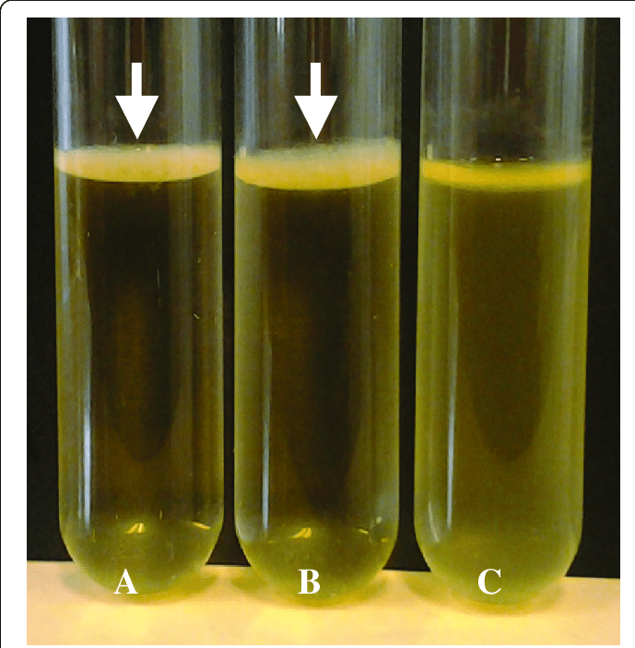
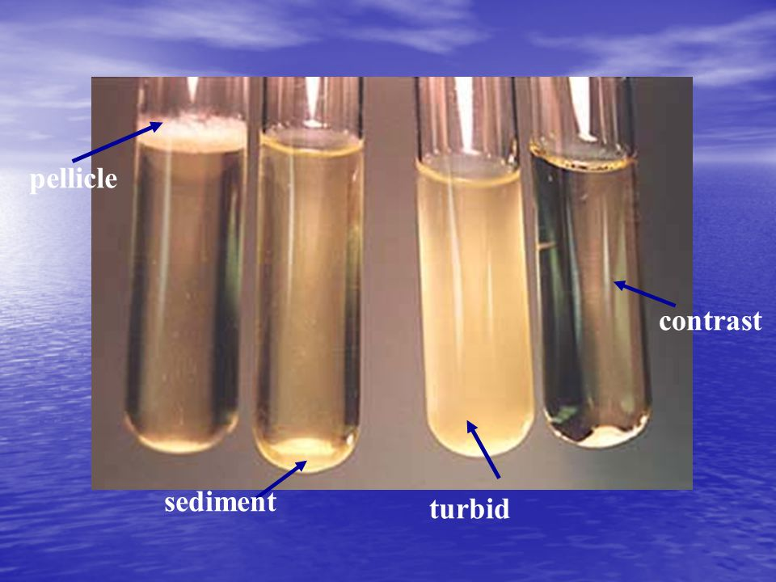
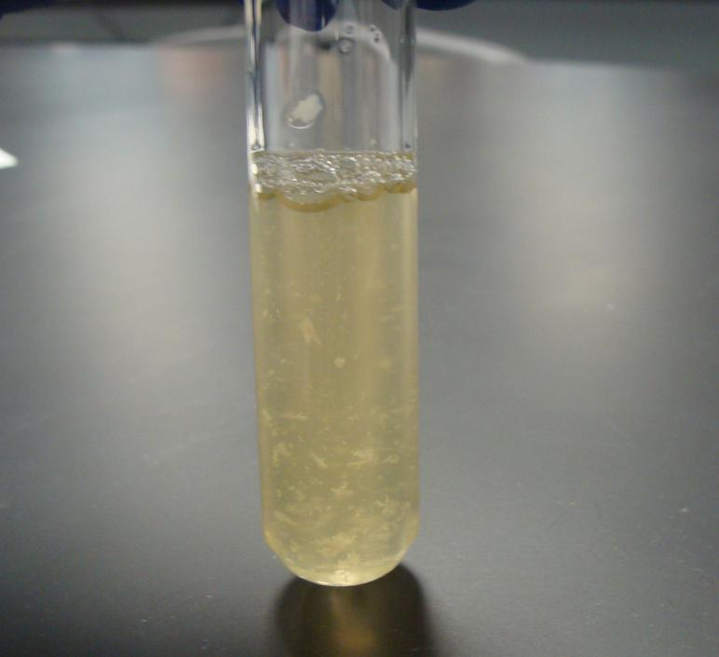
Pellicle
Sediment
Uniform fine distribution
flocculent
The bacteria grow
On the surface
The bacteria grow
in the bottom of the media
The bacteria grow
throughout the media
(Turbidity)
Floating membranes dispersed throughout the media

Slide 9
Nutrient Agar Slant
Flame the mouth of the agar slant tube before and after opening the lid
Take one loopful from your pure culture by using a sterile cooled loop
Place loopful at the bottom of the slant and gently drag it to the top to get a single-line inoculation
Reflame the mouth of the tube and close the lid
Incubate it for 24 hour
Take the results according to the following parameters:
Abundance of the growth, Pigmentation, optical characters, form

Slide 10

Slant
Your pure culture
Butt
Incubate overnight

Slide 11
The results of bacterial growth on nutrient agar slant are reported to the according following parameters:
Abundance of growth:
- No growth
- Small - slight growth
- Medium - moderate growth
- Large - heavy growth
Pigmentation:
- No pigment: pigment non-producer
- Pigment: pigment producer
Form:
- Filiform: Uniform growth along the line of inoculation
- Echinulate: Growth margins appear toothlike
- Beaded: Separate colonies grow along the line of inoculation
- Effuse: Separate colonies grow along the line of inoculation with slight growth in between
- Arborescent: Branched, tree-like growth
- Rhizoid: Rootlike appearance
Optical characteristics:
Compare your tube to one with pure media:
- Transparent: Transmit 100% of light
- Translucent: Transmit <100%
- opaque: Transmit 0%

Slide 12
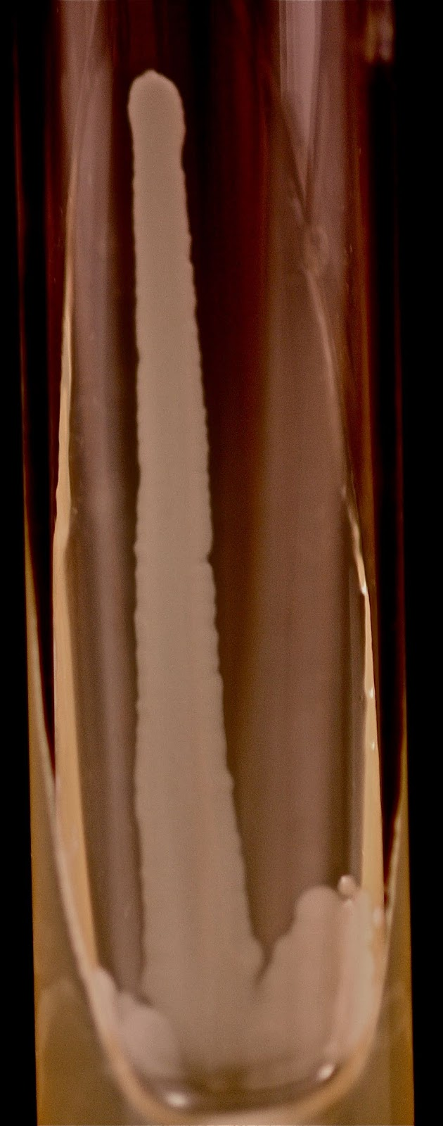
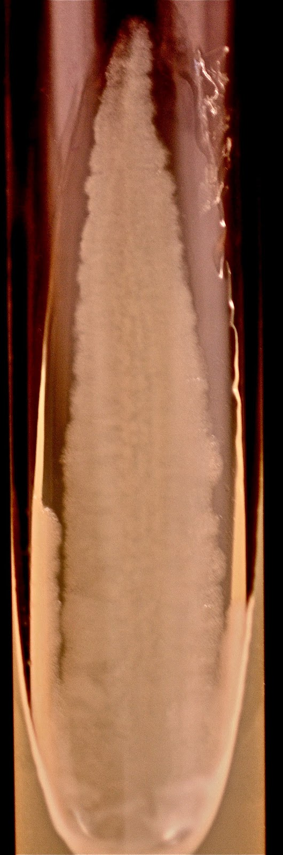
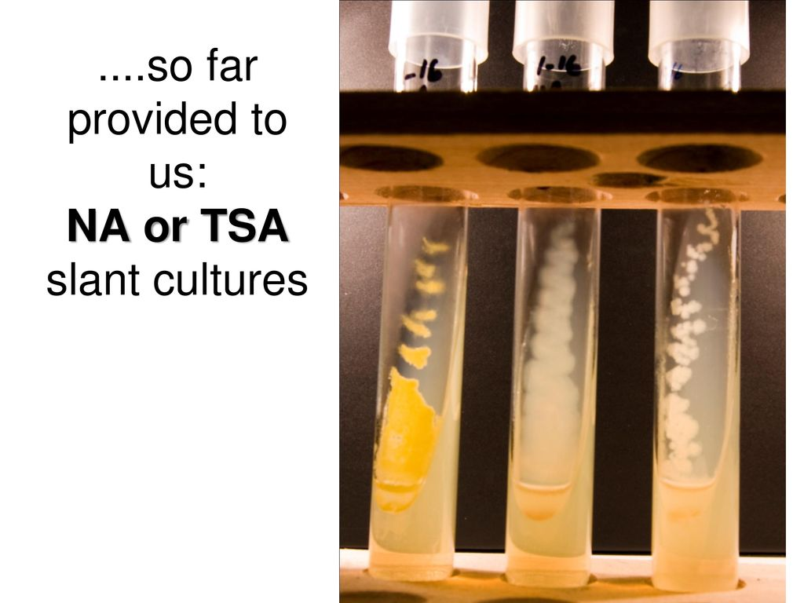
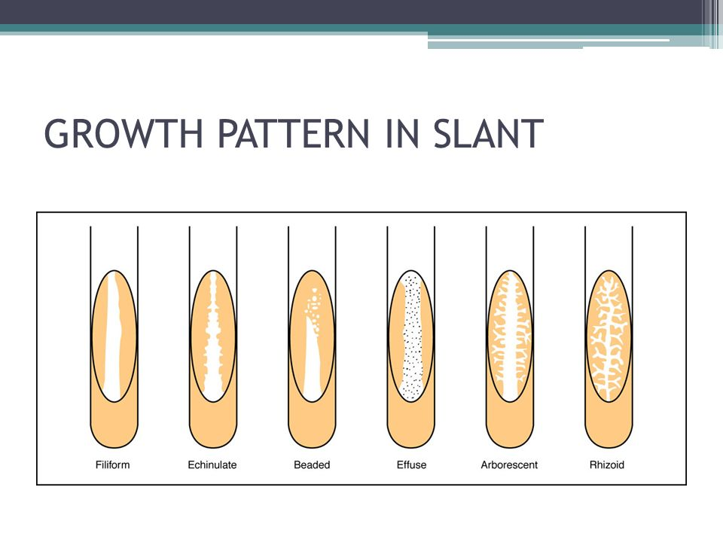
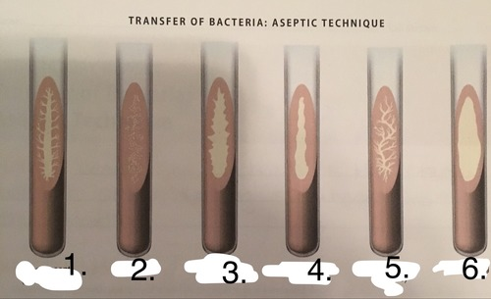
Filiform
Echinulate
Beaded
Effuse
arborescent
rhizoid

Slide 13
The Filiform and the Echinulate forms differ from each other in the edges:
Filiform: the edges are smoothly undulate
Echinulate: the edges are sharp

Slide 14
The arborescent and the rhizoid forms are differ from each other in the middle trunk:
- Arborescent: the middle trunk is thickest
- Rhizoid: the lines are net-like and equal in thickness

Slide 15
You can differentiate between beaded and effuse forms by:
Take a loopful in between the beads and carry out a simple stain
- If there is no bacteria on the slide, it means that the colonies are completely separate – (beaded)
- If there is bacteria on the slide, it means that the colonies are fused together by a transparent bacterial film – (effuse)
Beaded
Effuse

Slide 16
The bacterial growth can be controlled by:
1. Chemical factors: Antiseptic, Antibiotic
2. Physical factors: Temperature, pH, Osmotic pressure, O2 requirements

Slide 17
O2 is used in our bodies in the mitochondria of our cells during the cellular respiration
O2 is the final electron and proton acceptor in the electron transport system
Cytochrome is the final electron carrier
Superoxide dismutase enzyme converts the O2- radical to H2O2 + O2
- Catalase enzyme converts H2O2 to H2O + 1/2O2
Superoxide dismutase
Catalase
+ H2O

Slide 18
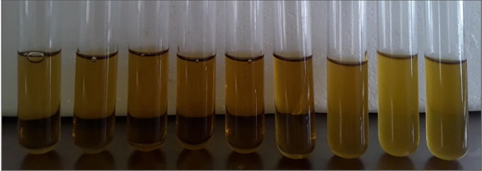
Brain Heart Infusion Agar
Brain heart infusion (BHI) is a growth medium, used to determine the oxygen requirement of different types of bacteria
- BHI contains a reducing agent which absorbs O2, causing O2 concentration to decrease with depth

Slide 19
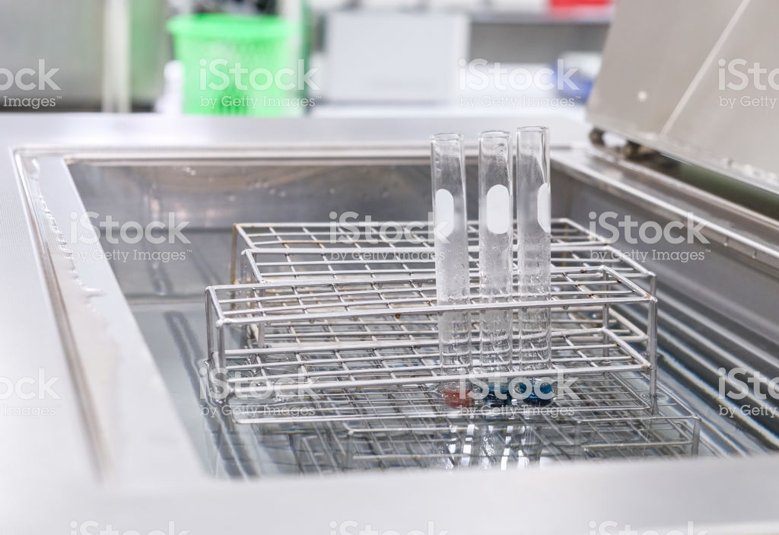
Your pure culture
BHI
Kept at 60˚ C
Cool to about 45 ˚ C
Inoculate by loopful of your pure culture
Mix very well by vortex to get a uniform distribution of bacteria
Incubate in the incubator at optimum temperature for 3 days then take the result by observing where the bacteria grow
Cool it as fast as possible under tap water to fix the bacterial cell where it is

Slide 20
Brain Heart Infusion Agar
Remove the molten brain-heart infusion tube from the water bath, and cool it to 45˚C
Flame the mouth of the brain-heart infusion tube before and after opening the lid
Using a sterile inoculating loop, transfer two loopfuls from your pure culture to the tube and gently shake the loop to disperse the bacteria
Reflame the mouth of the tube and close the lid
Vortex very well until bacteria is uniformly distributed
Immediately cool the tube under running water to solidify the media
Incubate for three days, and record the result depend where the bacteria grew

Slide 21


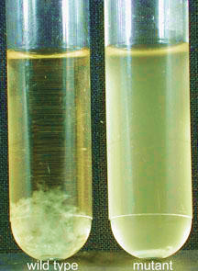
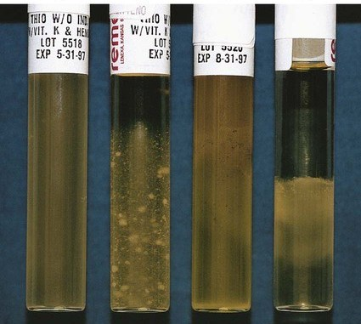

Aerobic
Microaerophilic
Anaerobic
Aerotolerant anaerobic
Facultative
anaerobic
Uneven distribution of the growth from top to bottom (more growth at the top)
The growth is only at the surface of the media
The growth is just below the surface of the media
The growth is only at the bottom of the media
Uniform growth from the top to the bottom

Slide 22
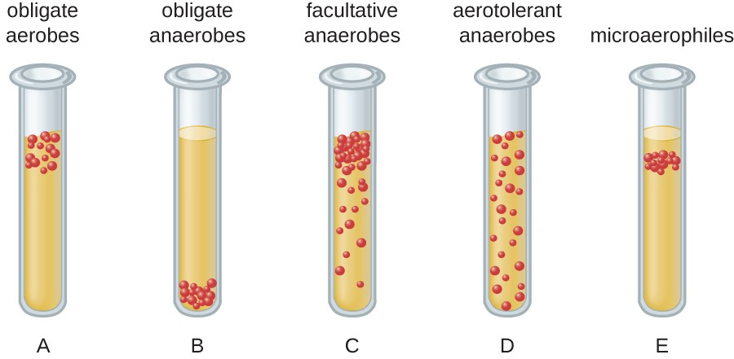

Slide 23
Type of bacteria | Bacterial Growth | O2 requirement | Enzyme
Aerobic | The growth is only at the surface of the media | The bacteria require the presence of oxygen to grow | Contain catalase and superoxide dismutase.
Microaerophilic | The growth is just below the surface of the media | The bacteria that require limited amounts of oxygen for growth. | Contain catalase or superoxide dismutase
Aerotolerant anaerobic | Uniform growth from the top to the bottom | The bacteria do not use oxygen as a final electron acceptor | Contain manganese ions and catalase.
Facultative anaerobic | Uneven distribution of the growth from top to bottom (more growth at the top) | The bacteria grow with and without oxygen, but they prefer oxygen | Contain catalase and superoxide dismutase
Anaerobic | The growth is only at the bottom of the media | The bacteria that require the absence of oxygen to grow | Do not contain catalase and superoxide dismutase

Slide 24
After incubation overnight and reading your results, keep your work to be used during the next lab as follows:
1. Nutrient broth (Keep in the refrigerator)
2. Nutrient agar slant (Discard in the identified basket)
3. Brain Heart Infusion Agar (Discard in the identified basket)
Always keep your pure culture in the refrigerator

Slide 25
Type of media | Status | % of the solidifying agent (Agar) | Example
X | Solid | > 1% | Nutrient agar slant
Y | Liquid | 0% | Nutrient broth
Z | Semisolid | < 1% | Brain heart infusion agar

Slide 26
1
2
3
4
5
6

